Slide 1
Take your child to work day activity: Coding PUZZLES!
A beginners guide

Slide 2
agenda
Introductions
Quick Activity
Start coding
Minecraft Puzzles

Slide 3
introduction
Who are we? Why are we here?
Introduce yourselves to your neighbor!
SUPERPOWER?

Slide 4
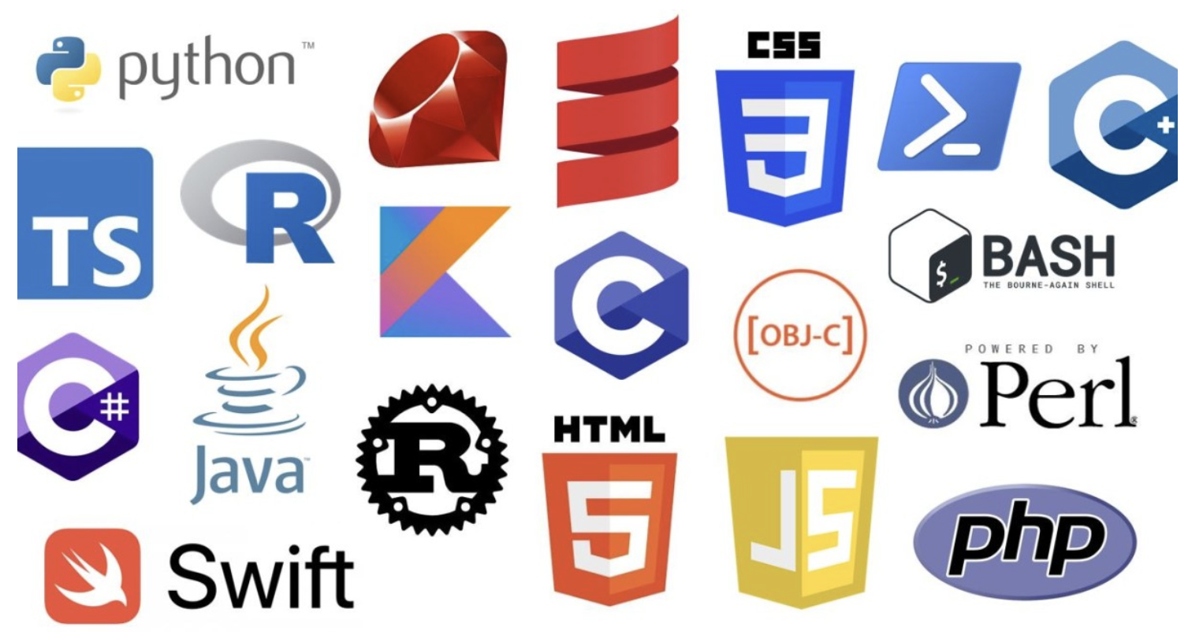
What is coding?
Coding is the process of giving instructions to a computer to perform specific tasks.
Just like giving directions to a friend, we use a language that computers understand.
What are some coding languages?

Slide 5
DRAWING ACTIVITY
1 = Instructor, 2 = Drawer (We will tell the instructor a SECRET object
WITHOUT revealing the secret object, the instructor will describe how to draw that object to the drawer
The Drawer CANNOT speak or ask any questions
Notes:
Need pen and paper, drawing of different objects in a bowl, need candy to give out

Slide 6
What did we learn?
Instructions need to be clear
You don’t always get it right on the first try, and that’s okay ☺

Slide 7
What is python, and why are we using it?
Python is a beginner-friendly programming language known for its simplicity and readability.
It's like learning a new language, but instead of speaking to people, we're talking to computers!
How many of you are learning a new language?

Slide 8
LETS TRY! Print Hello World
https://www.w3schools.com/python/trypython.asp?filename=demo_default

Slide 9


CHALLENGE 1
https://www.w3schools.com/python/exercise.asp?filename=exercise_syntax1
Notes:
Create handout/document with links for kids to click on (put on github)
Each computer needs this handout on it.

Slide 10
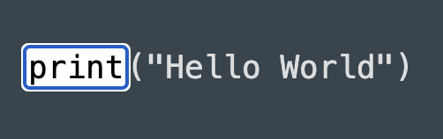
CHALLENGE 1 Example

Slide 11
Variables and Data Types
Variable = a name given to a memory location (ex. x = 2)
Datatype = categorization of knowledge item (ex. string, numeric, list, dictionary, etc.)
https://www.w3schools.com/python/trypython.asp?filename=demo_variables1
Notes:
Put in explanation for variables and data types

Slide 12
CHALLENGE 2
https://www.w3schools.com/python/exercise.asp?filename=exercise_variables1

Slide 13
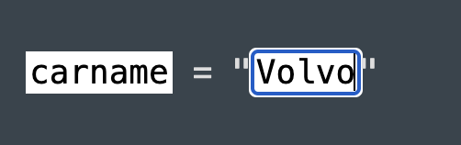
CHALLENGE 2 Example

Slide 14
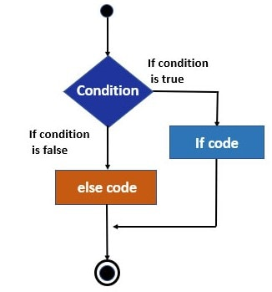
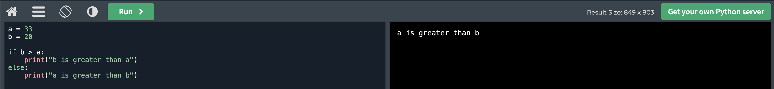
Conditional Statements (If Else)
Statements that allow you to control the flow of your program based on conditions that you specify
https://www.w3schools.com/python/trypython.asp?filename=demo_if2
Notes:
Add explanation here

Slide 15
CHALLENGE 3
https://www.w3schools.com/python/exercise.asp?filename=exercise_ifelse1

Slide 16
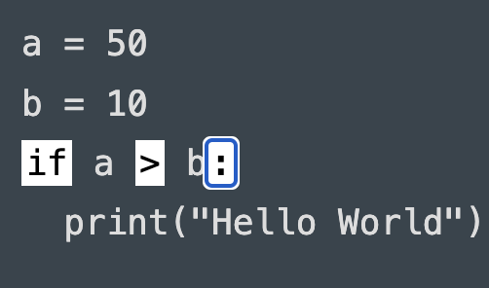
CHALLENGE 3 example

Slide 17
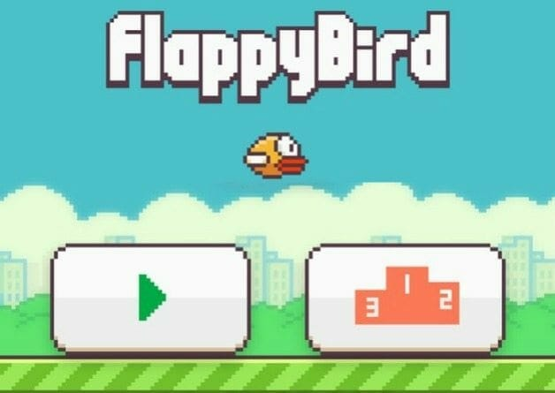
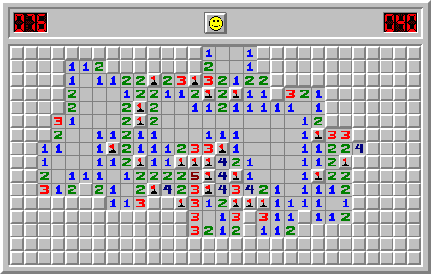
Games Made with Python

Slide 18
CODING Puzzles IN MINECRAFT
https://studio.code.org/s/aquatic/lessons/1/levels/1

Slide 19
THANK YOU!
Nitya Narayan
William Liu
Vignesh Cheriath
Rajan Verma

